Slide 1
Short-Term Internet Penetration Trends in Zimbabwe (2020–2025): A Big Data Analysis of Usage Patterns and Their Role in Shaping the Economy Through Retail, Agriculture, and Healthcare Sectors.
Faith Kabanda
N02425179W
SIDS5204
Big Data Science Project Presentation

Slide 2
Background
Problem statement
Internet as a Growth Enabler: The internet drives innovation in business, healthcare, and agriculture in Zimbabwe, but challenges like high data costs and poor connectivity limit its impact.
Benefits: SMEs use digital platforms for marketing and payments; healthcare leverages telemedicine; and agriculture benefits from digital advisory tools.
Persistent Barriers: Infrastructure limitations, high costs, and low digital literacy hinder widespread digital adoption.
Study Focus: This study explores internet penetration, social media trends, and the role of big data and machine learning to recommend strategies for improving digital access and inclusion.
Internet as Digital Divide: Zimbabwe faces uneven internet access, with rural areas especially disadvantaged due to poor infrastructure and high data costs.
Sectoral Impact: SMEs, healthcare providers, and farmers struggle to fully adopt digital tools, limiting their efficiency and growth potential.
Economic Consequences: Limited connectivity reduces market access for businesses, hinders healthcare delivery, and lowers agricultural productivity.
Study Purpose: The study focuses on internet usage trends to recommend strategies for improving connectivity, affordability, and digital literacy to support national economic development..

Slide 3

Aim And Research questions
Aim
The aim of this study is to analyse and predict internet penetration trends in Zimbabwe using big data analytics, focusing on how improved internet access can enhance SMEs, healthcare, and agriculture, and in turn, contribute to economic growth through digital inclusion.
Research Questions
What have been the historical internet penetration trends in Zimbabwe, and how can big data analytics be used to analyse them?
What are the emerging social media usage patterns in Zimbabwe?
How can a predictive model be developed to estimate future internet penetration in Zimbabwe?
What data-driven strategies can be recommended to enhance digital inclusion and promote economic growth in Zimbabwe?

Slide 4


Literature Review
Digital Infrastructure and Inclusion Gap: Zimbabwe faces high data costs, limited infrastructure, and low digital skills, particularly in rural areas, hindering the full economic impact of internet tools across retail, healthcare, and agriculture.
Underutilized Machine Learning Techniques: Although ML methods like decision trees, random forests, SVMs, KNN, deep learning, and linear regression show promise in analyzing internet trends, there is a major research gap in applying these models to Zimbabwe-specific data and contexts.
Adoption Challenges: While SMEs use platforms like WhatsApp and Facebook for growth, many rural businesses struggle due to digital illiteracy and weak infrastructure; healthcare adoption of telemedicine is limited by unstable connectivity; agriculture lacks real-time data access and support systems, revealing a consistent pattern of under-adoption due to structural barriers.
Comparative Lag in Policy and Support: Unlike South Africa and Kenya, Zimbabwe lacks sufficient policy frameworks, financial incentives, and infrastructure investment to support digitalization across key sectors, particularly in healthcare and agriculture.

Slide 5


Research methodology
Big Data Analytics Approach: The study used big data analytics to analyse internet penetration trends in Zimbabwe and its impact on retail, healthcare, and agriculture from 2020 to 2025.
Data Sources: Data was collected from reputable sources, primarily the Data Reportal Website, with reports from We Are Social & Meltwater, covering trends in digital penetration and internet use in Zimbabwe.
Data Challenges: The data was unstructured (narrative text), requiring manual extraction for analysis. This included cross-checking data from multiple sources like GSMA Intelligence to ensure accuracy.
Data Variables: Key variables for analysis included population data, internet users, social media users, mobile connections, and urban vs. rural distribution, with age data excluded during feature engineering.
Data Pre-processing & Tools: Python was used to preprocess the data, employing tools like pandas, matplotlib, numpy, and sklearn.linear_model for analysis.
Modelling & Forecasting: The study utilized linear regression for model development due to its simplicity and interpretability, with prediction accuracy assessed using Mean Absolute Error (MAE).
Ethical Considerations: The study adhered to ethical standards by using publicly available, authorized data, ensuring transparency and avoiding the misuse of personal information, and adhering to data protection regulations.

Slide 6
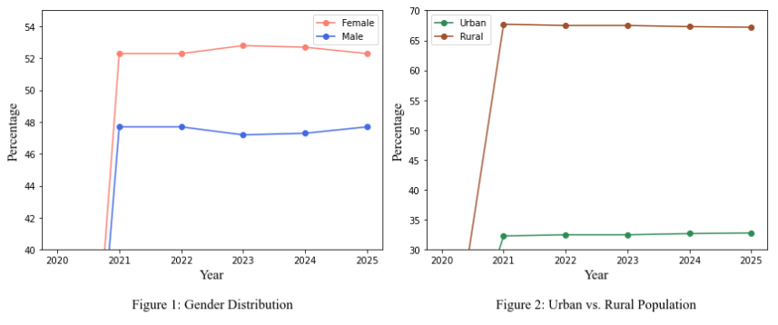
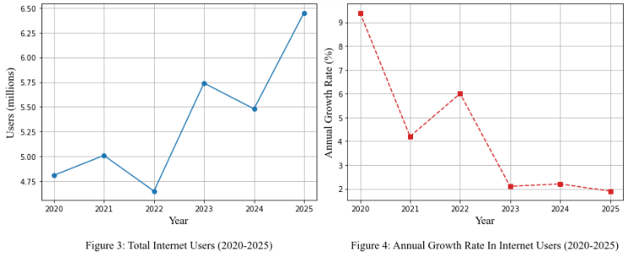
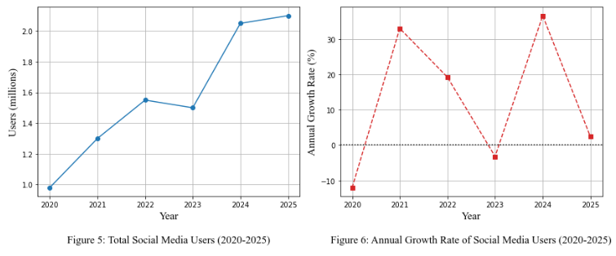
results
The demographic data of Zimbabwe from 2020 to 2025, as shown in Figure 1 and Figure 2 on the left, show a steady increase in population, growing from approximately .
From 2020 to 2025, as shown in Figure 3 and Figure 4 on the left, internet usage trends in Zimbabwe revealed significant fluctuations in user numbers, growth rates, and penetration levels.
The fluctuations in social media usage in Zimbabwe between 2020 and 2025, as shown in figure 5 and 6 above, highlight significant shifts in digital engagement and accessibility

Slide 7

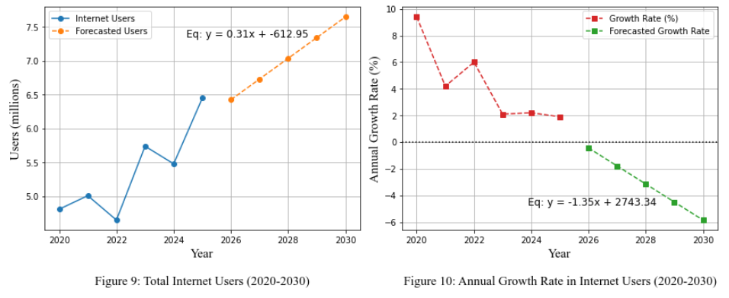
Results: Forecast – linear regression
The forecast results in figure 9 and 10 above, suggest that Zimbabwe's internet user base will continue growing, but at a declining rate.
As indicated by Figure 10’s regression equation y=−1.35x+2743.34. The trend aligns with Murthy et al. (2021), who highlight that internet growth often slows as adoption reaches a larger share of the population.
An Mean Absolute Error (MAE),of 0.296 million means that, on average, the model's predictions for the total number of internet users are off by about 296,000 users per year.
Given the scale of users (in millions), this is a reasonably low error, indicating that the model is fairly accurate for user forecasting.

Slide 8
Thoughts on results
Unexpected Outcomes
Societal/Ethical Implications
Internet Fluctuations: Internet usage was expected to follow a steady upward trend, but unexpected drops were observed in 2022 and 2024. These declines were not anticipated and require further investigation to understand possible causes such as affordability issues, infrastructure challenges, or policy changes.
Social Media Dip: In contrast to internet usage, which dipped in 2022 and 2024, social media usage showed a separate decline in 2023. This decoupling suggests that different factors influence general internet access and specific platform usage.
Mobile Connection Plateau: Despite population growth, mobile connections did not increase proportionally, suggesting saturation or shifting usage patterns that warrant deeper analysis.
Data Collection Limitations: The data used was collected by external entities for broad reporting purposes, not specifically for research, which may affect its accuracy or relevance.
Privacy Concerns: Relying on third-party digital data raises concerns about user consent and privacy, especially when individuals are unaware of how their data may be reused.
Misinterpretation Risk: There is a risk of misinterpreting or overgeneralizing patterns from such data, potentially leading to policy decisions that do not reflect the lived realities of underrepresented groups.

Slide 9

Final thoughts
conclusion
Recommendations
The study successfully addressed the first three research questions by analysing:
historical internet penetration trends
social media usage patterns
developing a predictive linear regression model for Zimbabwe's digital landscape
The linear regression model was developed to forecast internet user trends, yielding a Mean Absolute Error (MAE) of 0.296 million users and 1.241% for growth rate, highlighting reasonable predictive accuracy for high-level planning.
The research’s findings offered a foundational understanding of Zimbabwe’s digital evolution
Improve Digital Infrastructure
Promote Affordable Internet Access
Enhance Digital Literacy
Gaps For Future Research
Impact of Digital Policies
Evolving Role of Social-Media

Slide 10
Thank you
GitHub Link- https://github.com/faithkabanda/2025-SIDS5204-Big-Data-Science-Project.git

